Slide 1
COMP6049 – Algorithm Design and Analysis
Topic 21 – Backtracking

Slide 2
Outline Materials
Concept of Backtracking
N-Queen Problem

Slide 3
SEARCH TREE
For some cases of algorithms, in each step of
algorithm there are several options and must decide to choose one of them.
The decision made will affect the next choice, which the algorithm must make a decision again, and so on until the final solution is achieved.
Finding solutions techniques can be described as a Search Tree.
The relationship between parent and children is a choice that should be decided in solving a problem.
The solution is right in one of the nodes tree, but we do not yet know which one. The algorithm made ​​aims to find which node is the solution.

Slide 4
N-QUEEN PROBLEM
Supposed we had a chessboard of N x N. This chessboard must be filled up with N Queen in such a way as the four these Queens did not threaten each other.
 | 1 | 2 | 3 | 4 | 5 | 6 | 7 | 8
1
2
3
4
5 |  |  | Q1
6
7
8

Slide 5
MODELING N-QUEEN PROBLEM
How can the N-Queen Problem solving be described by a Search Tree?
A number of N Queen should be put, it means that there are N decision
Each row of the chess board may be filled only by 1 Queen
Means that every decision will put 1 Queen in row N
Which must be decided is: in which column where the Queen should be placed

Slide 6
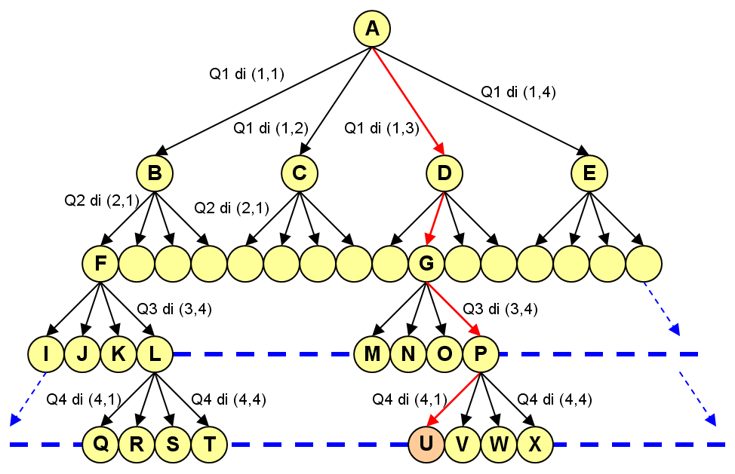
N-QUEEN SEARCH TREE

Slide 7
COMPLETE vs PARTIAL SEARCH TREE
Complete Search Tree can be very large
High complexity algorithm
It takes quite a while
Requires large storage memory
Often in a Search Tree, not all nodes need to be traced
Nodes are clearly not qualified to direct ignored
Nodes have a higher probability towards a solution can be opened first
Constraints of a problem used as a benchmark for tracing a node

Slide 8
BACKTRACKING
Backtracking is a technique for finding a solution to the Partial Search Tree
Search Tree is not as well established as a whole but one by one.
In every decision, an algorithm will calculate whether the "certain lines" in the tree is possibly for a solution.
If possible, the process will continue.
If not possible, the algorithm will cancel the decision paths that have been made, then do steps back (backtrack) and look for another path.
An example of popular application of basic techniques Backtracking algorithm is N-Queen Problem
For example, will use the value N = 4 (4-Queen Problem)

Slide 9
BACKTRACKING STEPS
Build the initial node as the active node (E-node)
With the E-node, track the next node with Depth First Search method
Check constraint, if the constraint is satisfied then state nodes as active nodes (E-node)
If constraint is not satisfied, declare the node as a dead node (D-node)
If the obtained D-node, backtrack to the E-node on it, then track to another branch
and so on until the desired solution is obtained

Slide 10
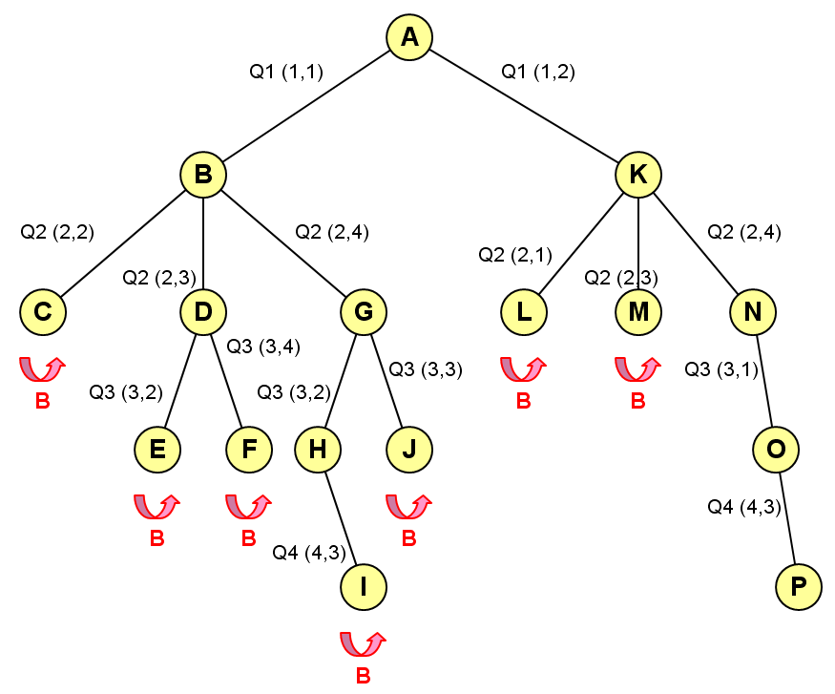
SEARCH TREE WITH BACKTRACKING

Slide 11
RESULTS OF 4-QUEEN PROBLEM
 | Q1
 |  |  | Q2
Q3
 |  | Q4
Finally, the node P obtained as a solution. Node P represents the choice of Q1 (1.2), Q2 (2.4), Q3 (3.1) and Q4 (4.3).

Slide 12
EXERCISE
Find a solution 5-Queen Problem using Bactracking technique!

Slide 13
REVIEW
Search tree
N-Queen problem
Modeling N-Queen problem
N-Queen search tree
Complete vs partial search tree
Backtracking
Backtracking steps
Search tree with backtracking
Results of 4-Queen problem

Slide 14
Q & A

Slide 15
References
S. Sridhar. 2014. Design and Analysis of Algorithms, 1/e. Oxford University Press. India. Chapter 14
Ellis Horowitz,Sanguthevar Rajasekaran,Sartaj Sahni. 1998. Computer algorithms/C++. 1STBL. New York. Chapter 7.1 & 7.2
Backtracking Algorithm
http://www.cs.cmu.edu/afs/cs/project/jair/pub/volume4/vanbeek96a-html/node6.html
Backtracking Algorithm www.hbmeyer.de/backtrack/achtdamen/autoacht.htm#up

Slide 16
THANK YOU

